Slide 1
ELIXIR Hands-on workshop Tromsø Nov. 2019
The national bioinformatics infrastructure
Erik Hjerde
Ståle Nygård
Nils Peder Willassen

Slide 2

Time schedule and course material
https://elixir.mf.uni-lj.si/course/view.php?id=50

Slide 3
Introduction to ELIXIR
A distributed European infrastructure for life-science information
Erik Hjerde

Slide 4











Erik Hjerde
Notes:
Tools, databases, storage, sharing, compute, common standards, educational resources

Slide 5
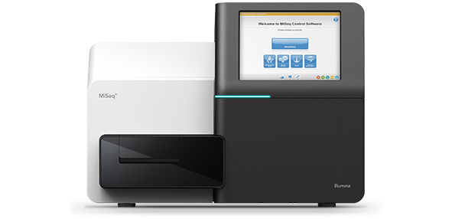
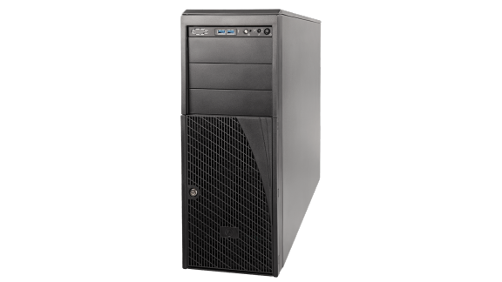
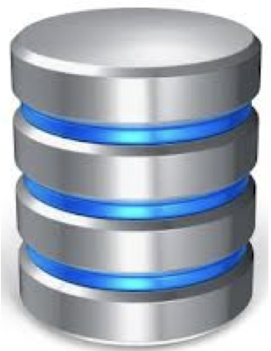
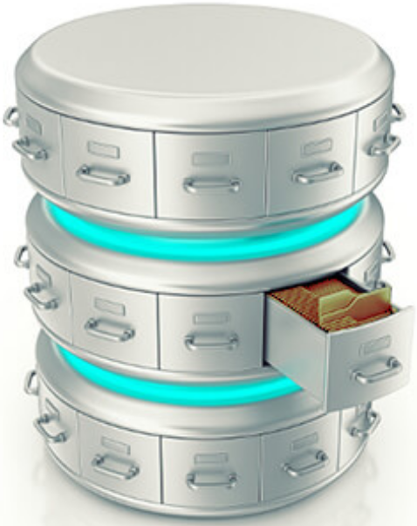

Do we need ELIXIR????????
Data production
Data storage/sharing
Data compute
Data archiving
Data management
Notes:
Flow in a typical life science project
Data management planning (required for all grant applications)

Slide 6

Do we need ELIXIR????????
100 samples
200 GB raw data
2 TB processed data
512 GB RAM
72 CPUs
100 000 hours
100 PE FASTQ
100 x ? MAGs
Data production
Data storage/sharing
Data compute
Data archiving
Data management
Data management plan
Notes:
Some numbers from a typical metagenome project

Slide 7

Do we need ELIXIR????????
100 samples
200 GB raw data
2 TB processed data
512 GB RAM
72 CPUs
100 000 hours
100 PE FASTQ
100 x ? MAGs
Data production
Data storage/sharing
Data compute
Data archiving
Data management
Data management plan
Notes:
ELIXIR can provide some helps

Slide 8

Do we need ELIXIR????????
100 samples
200 GB raw data
2 TB processed data
512 GB RAM
72 CPUs
100 000 hours
100 PE FASTQ
100 x ? MAGs
Data production
Data storage/sharing
Data compute
Data archiving
Data management
Training end users
Data management plan

Slide 9
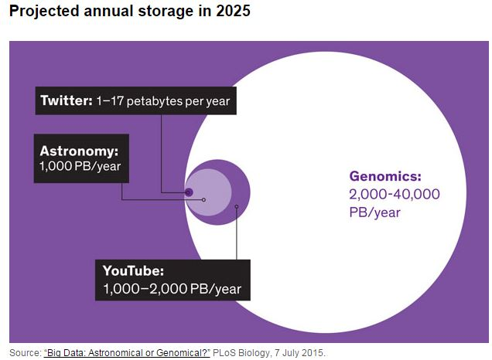
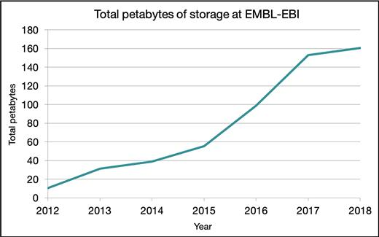
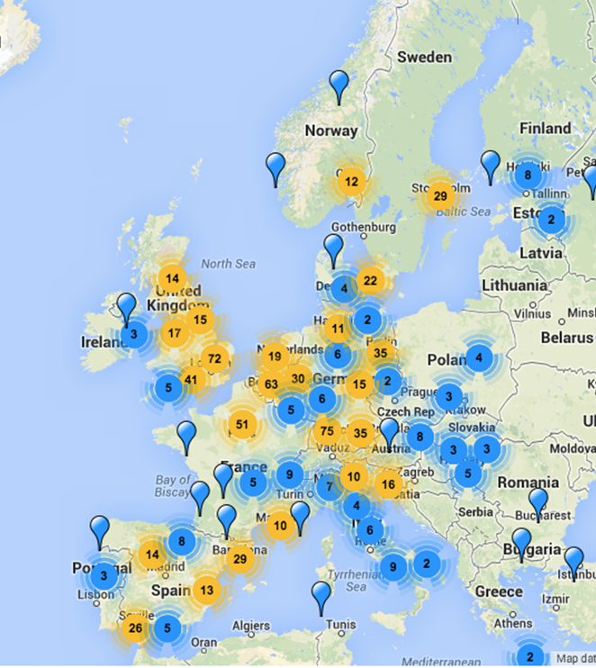
Production of data is enormous
1 PB is equivalent to over 4,000 digital photos per day, over your entire life
64 million requests for data per day
Notes:
Every second the total information produced in the world is one PB per second. 1 PB is equivalent to over 4,000 digital photos per day your entire life
Development in sequencing technologies is much faster than in computer hardware technologies – We will run out of storage
The total storage capacity at EMBL-EBI is 200 PB = 1 billion CD-ROM discs. This leads to lack of space capacity within 3 minutes

Slide 10
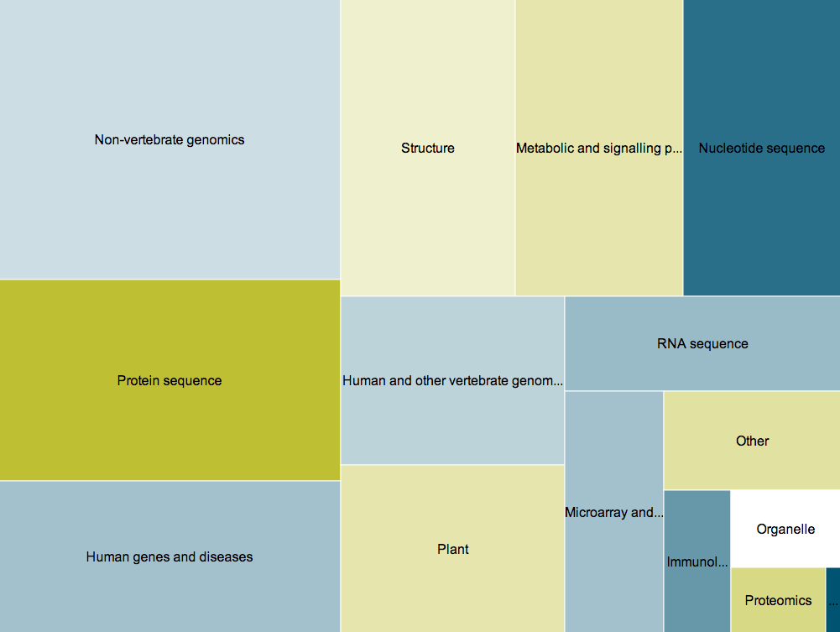
Life-science databases
Dispersed throughout the world, and serve many different research communities
1685
databases
Notes:
Just keeping track of the vast quantity is a job in itself.
We need a combination of the best people, financing and experience to solve the life science data challenges that lay ahead if we are going to reap the rewards of new technology.
Furthermore no one institute or organisation can deal with all this data. We need a distributed federated infrastructure to deal with the data challenges.

Slide 11
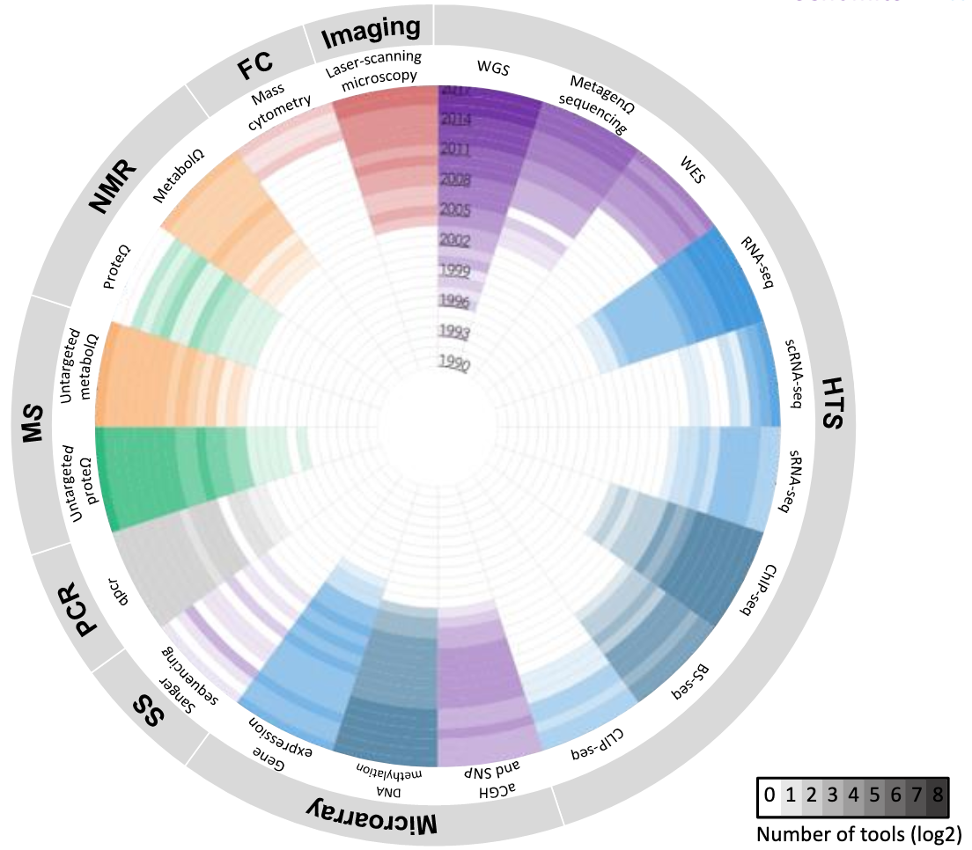
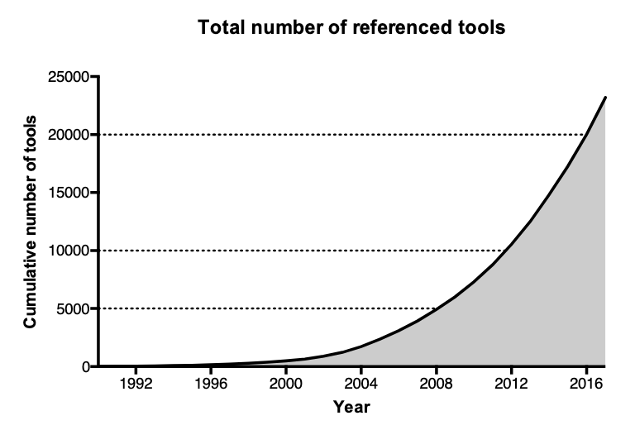

Bioinformatic tools
Crucial component of the infrastructure for life sciences
23000
tools
Clément Levin et al. 2018
Notes:
Evolution of 23000 bioinformatics tools from 1990 to 2017
Most widely used genomic software is developed by independent investigators working in academic or not-for-profit institutions with support from government grants. This software is generally freely available to the community, typically with no subscription or licensing fees and nonrestrictive terms of use. At the same time, it is often meagerly funded, unreliable, hard-to-use, poorly documented, and/or poorly supported.

Slide 12

We need common standards to describe data
Common data formats
Common ontology to describe eg. a gene
Common standards to describe metadata
Database registry
Tool registry
Notes:
There is a need for a federated way of keeping registries of all this.
We also need common standards to describe everything from the metadata of a sample, to the database and the tools used to analyse the data

Slide 13
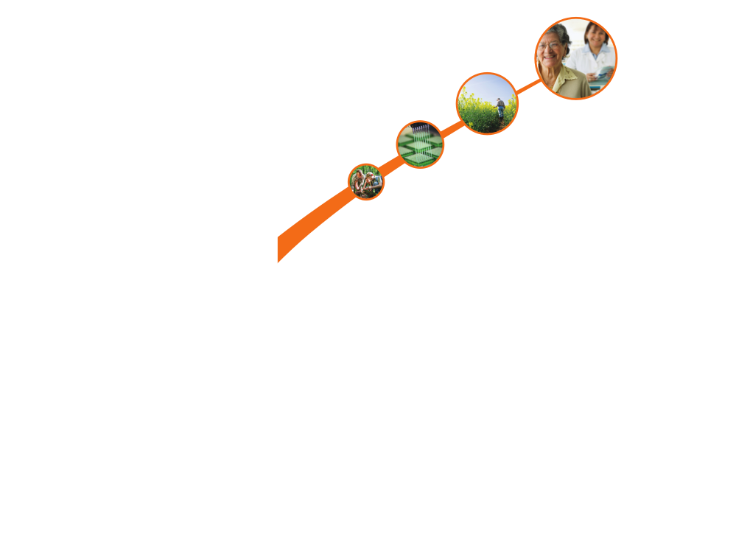
What is ELIXIR?
ELIXIR connects national bioinformatics centres and EMBL-EBI into a sustainable European infrastructure for biological research data
medicine
agriculture
bioindustries
ELIXIR underpins life science research – across academia and industry
environment

Slide 14
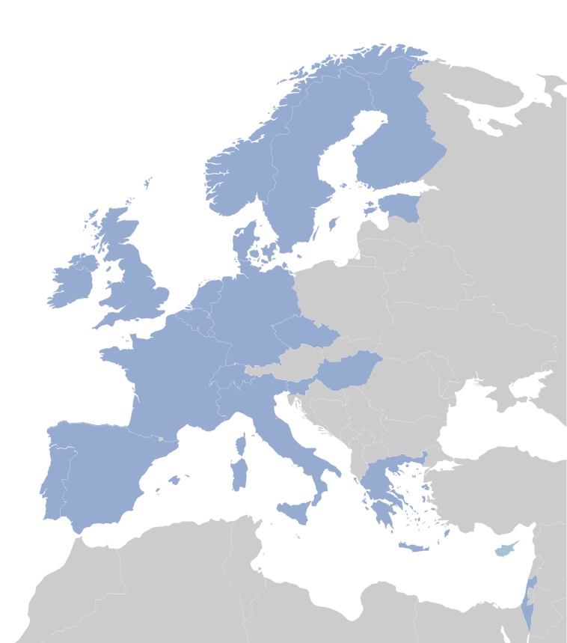
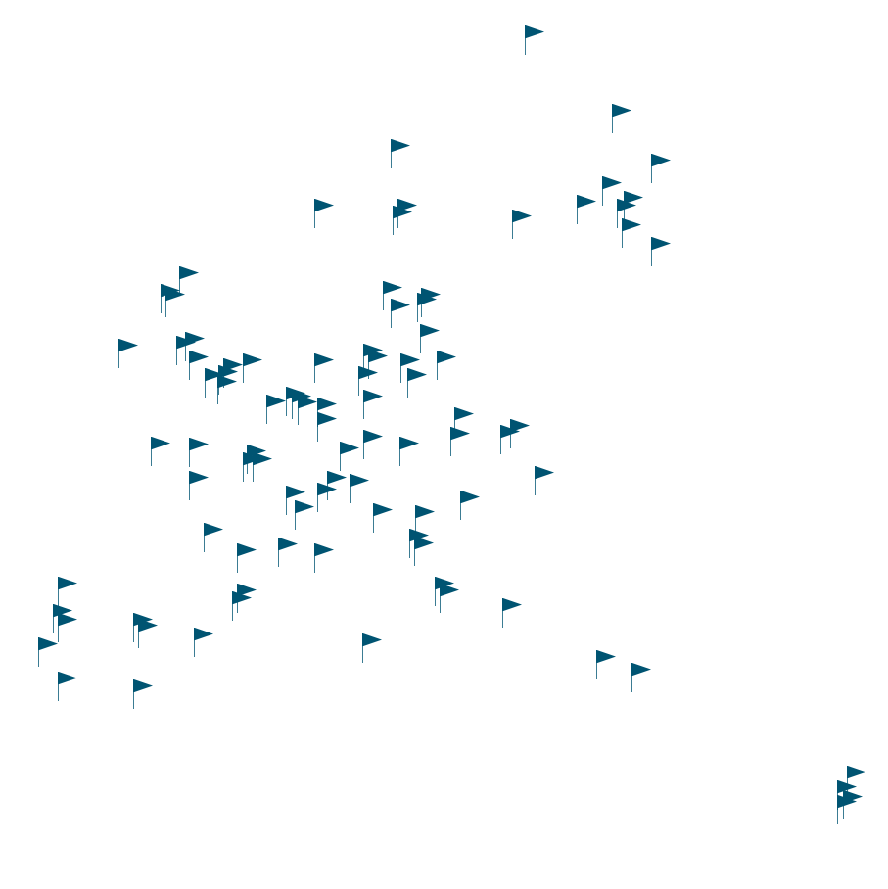
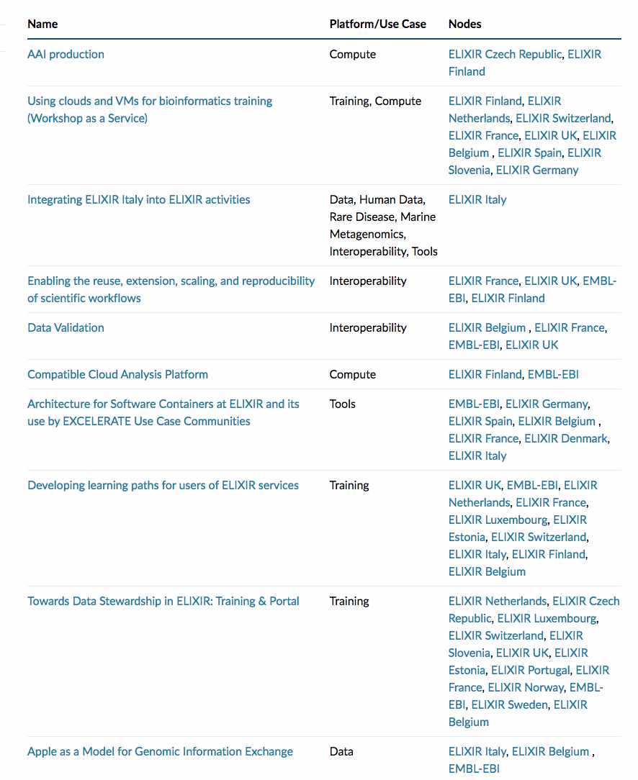
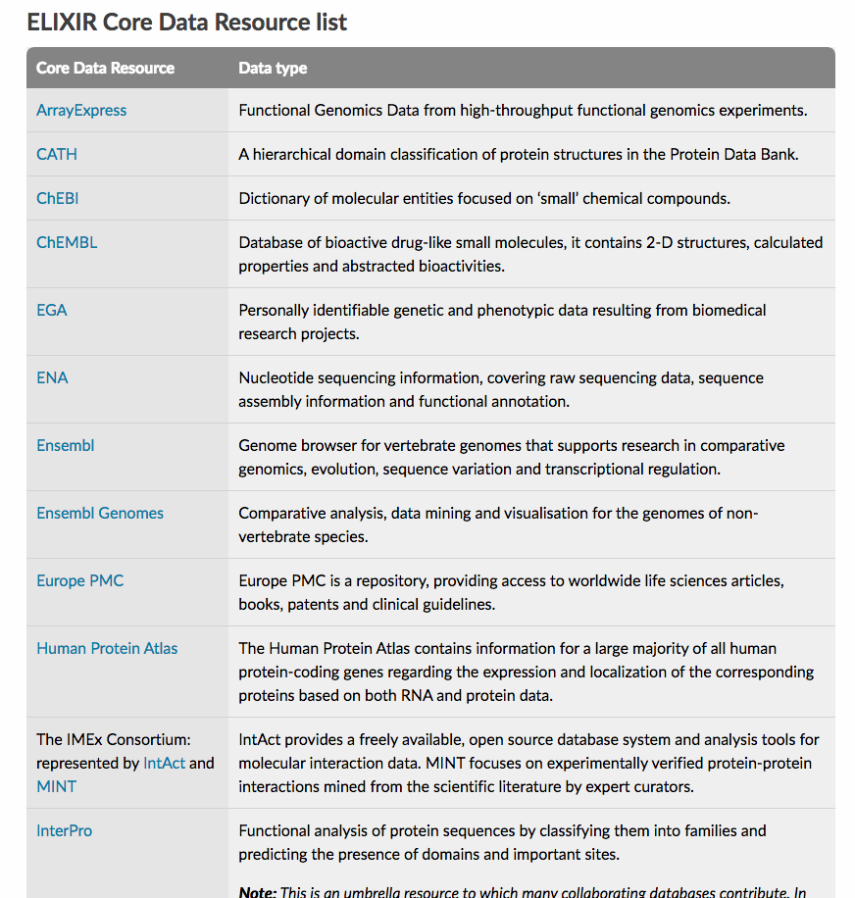
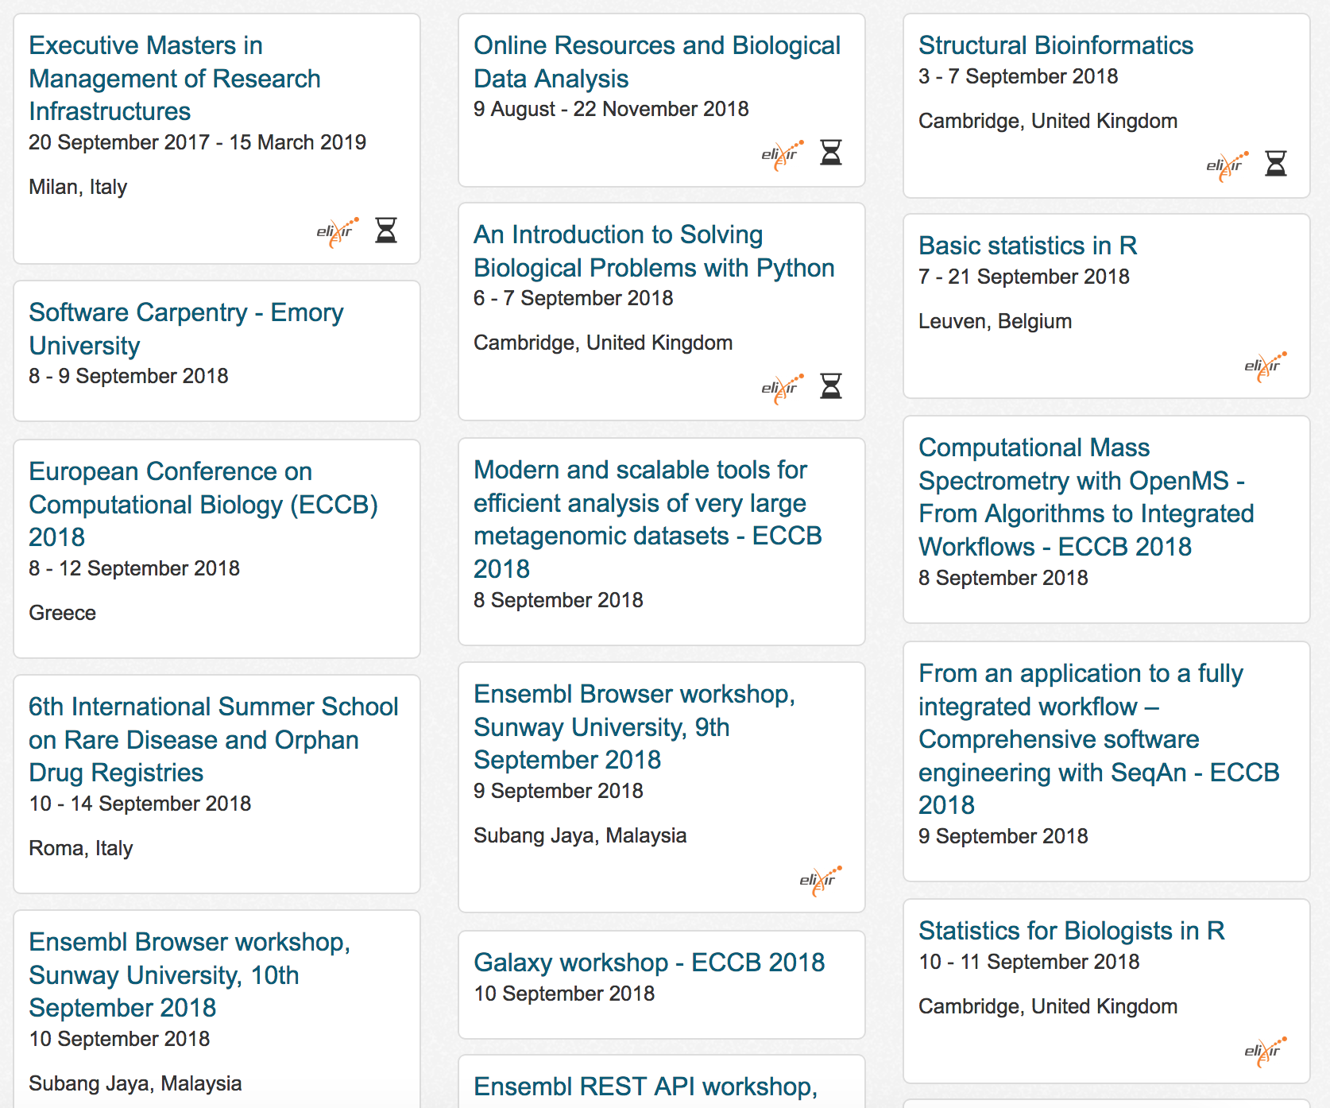
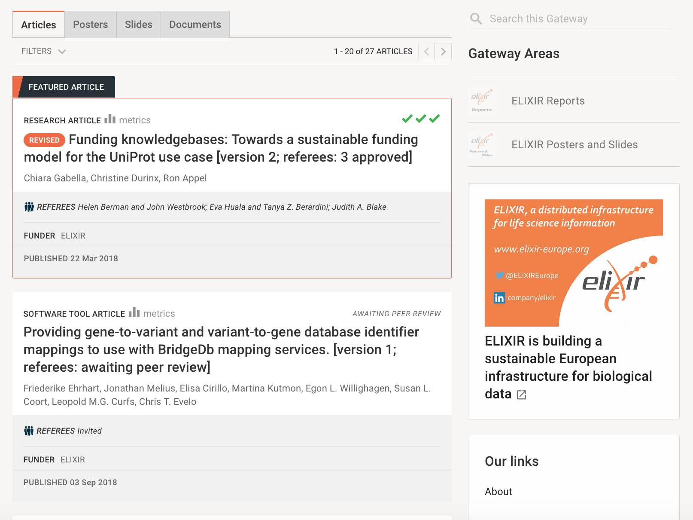
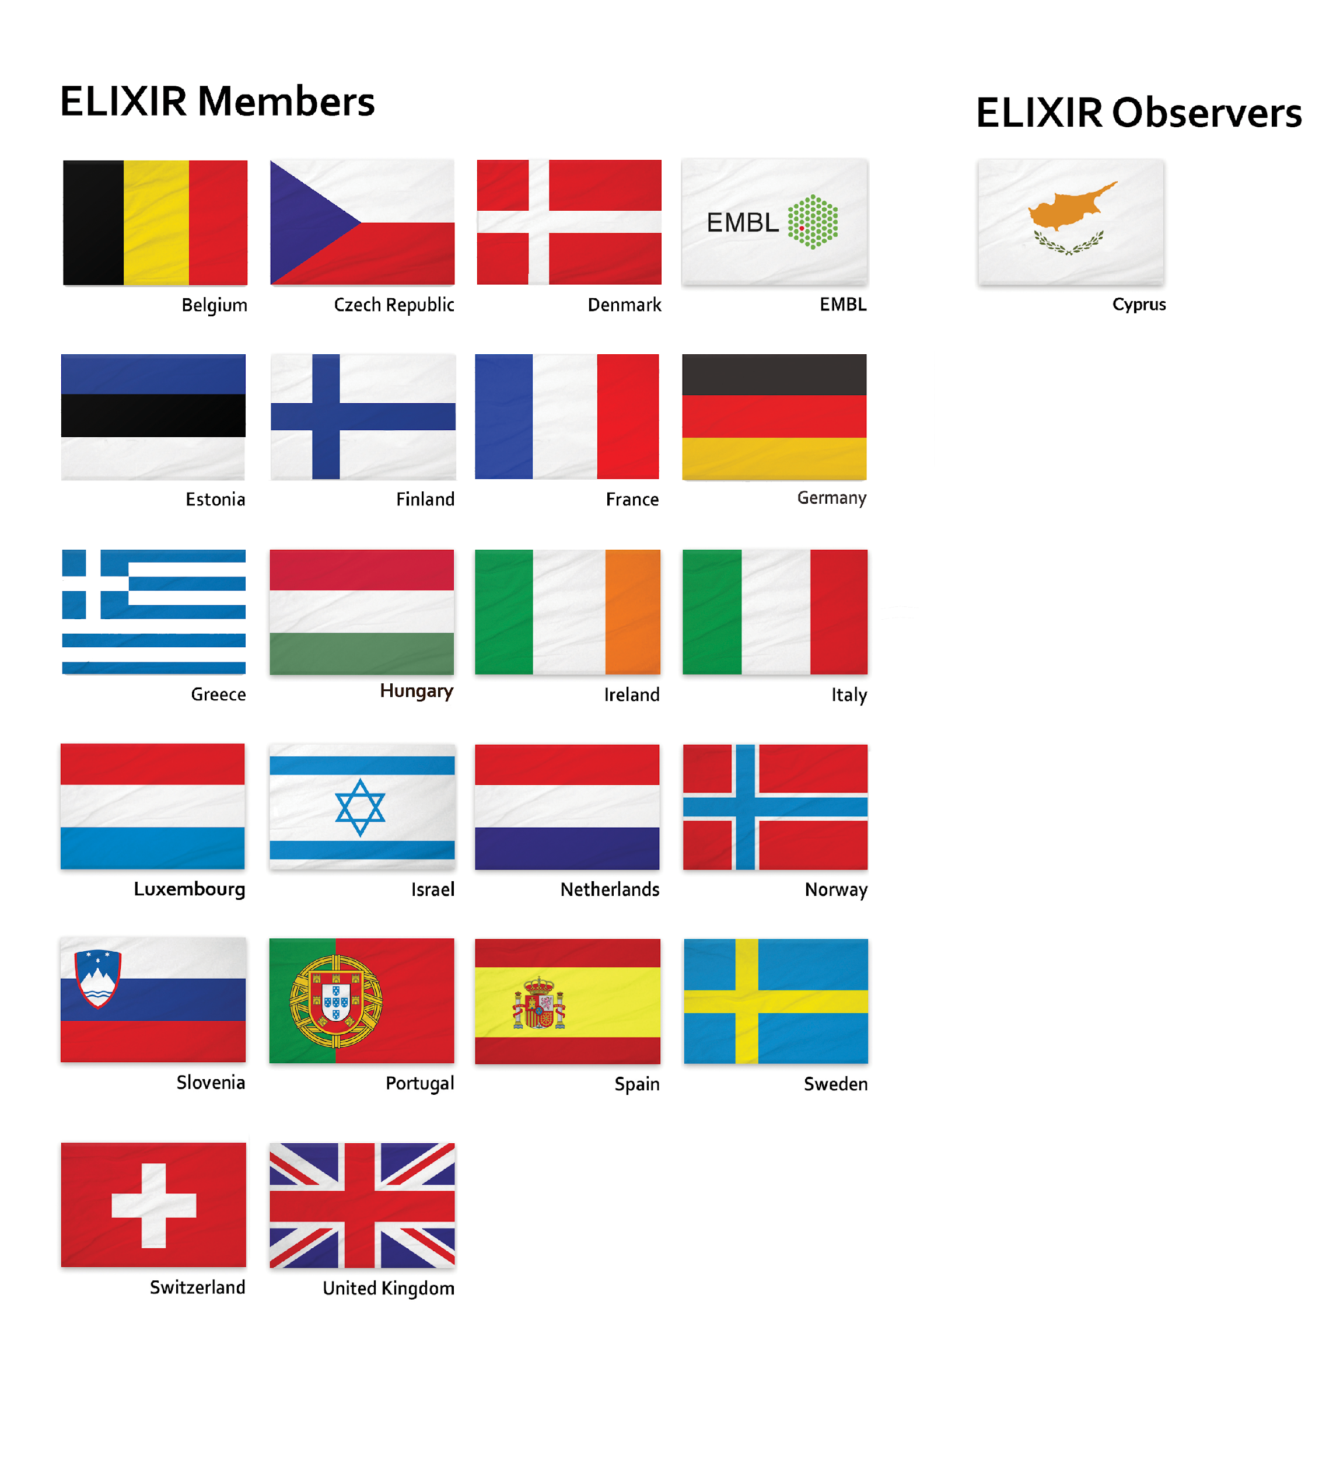
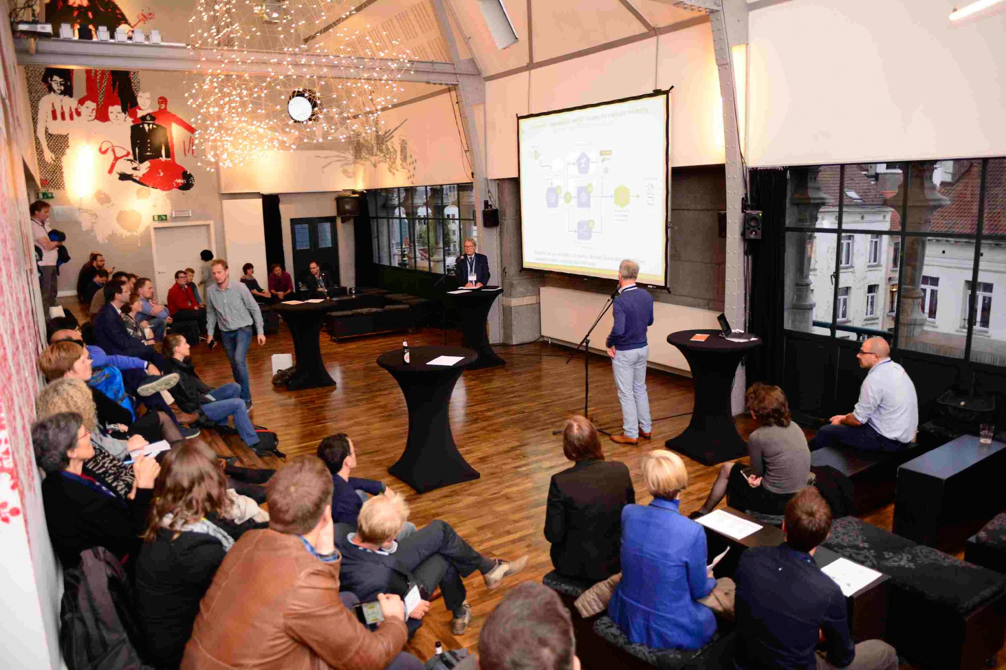
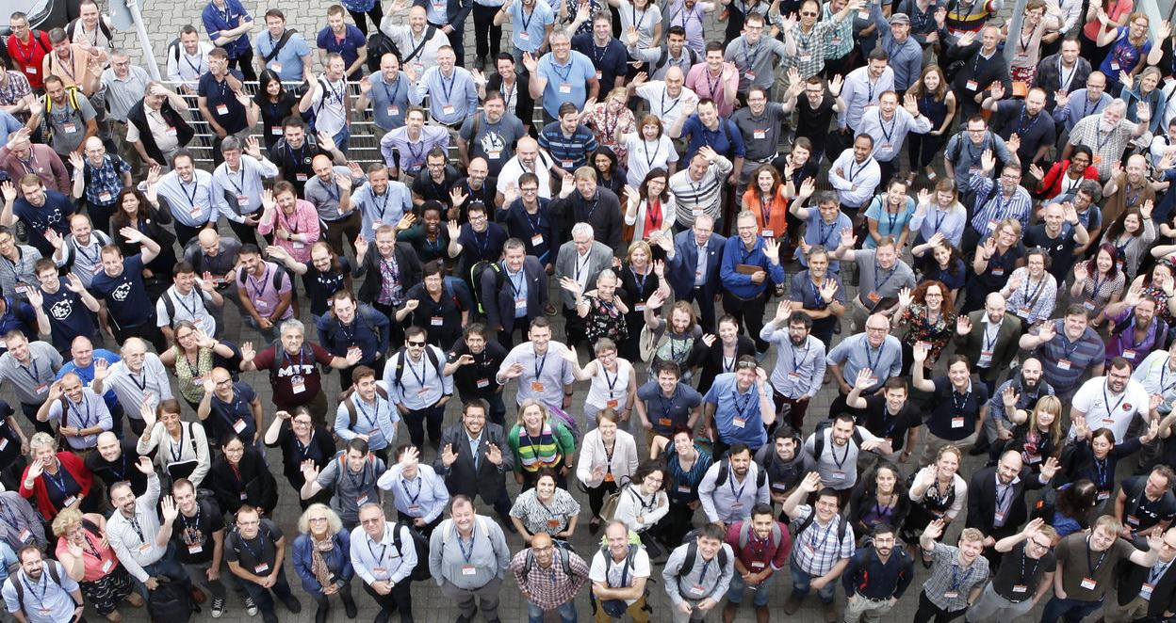
ELIXIR members
Notes:
Largest of all ESFRI RIs
Discussions initiated with Canada (Genome Canada), South Africa and Australia

Slide 15
ELIXIR in numbers
22 Members and 1 Observers
~ 180 institutes involved
700+ staff
18 Core Data Resources
21 Implementation Studies ongoing or soon to start
27 papers in ELIXIR F1000 channel
300 live events in TeSS
400 companies attended Innovation and SME programme
Notes:
ENA is one such Core data resource

Slide 16
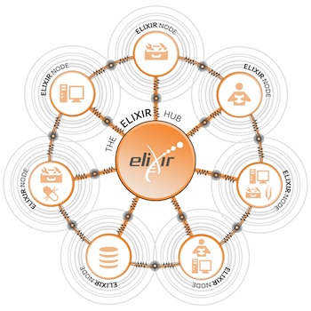
ELIXIR distributed European infrastructure
ELIXIR Nodes build local bioinformatics capacity throughout Europe
ELIXIR Nodes builds on national strengths and priorities
Nodes funded by national agencies
ELIXIR Hub funded jointly by ELIXIR member states
Notes:
ELIXIR – A distributed European infrastructure for life-science information

Slide 17
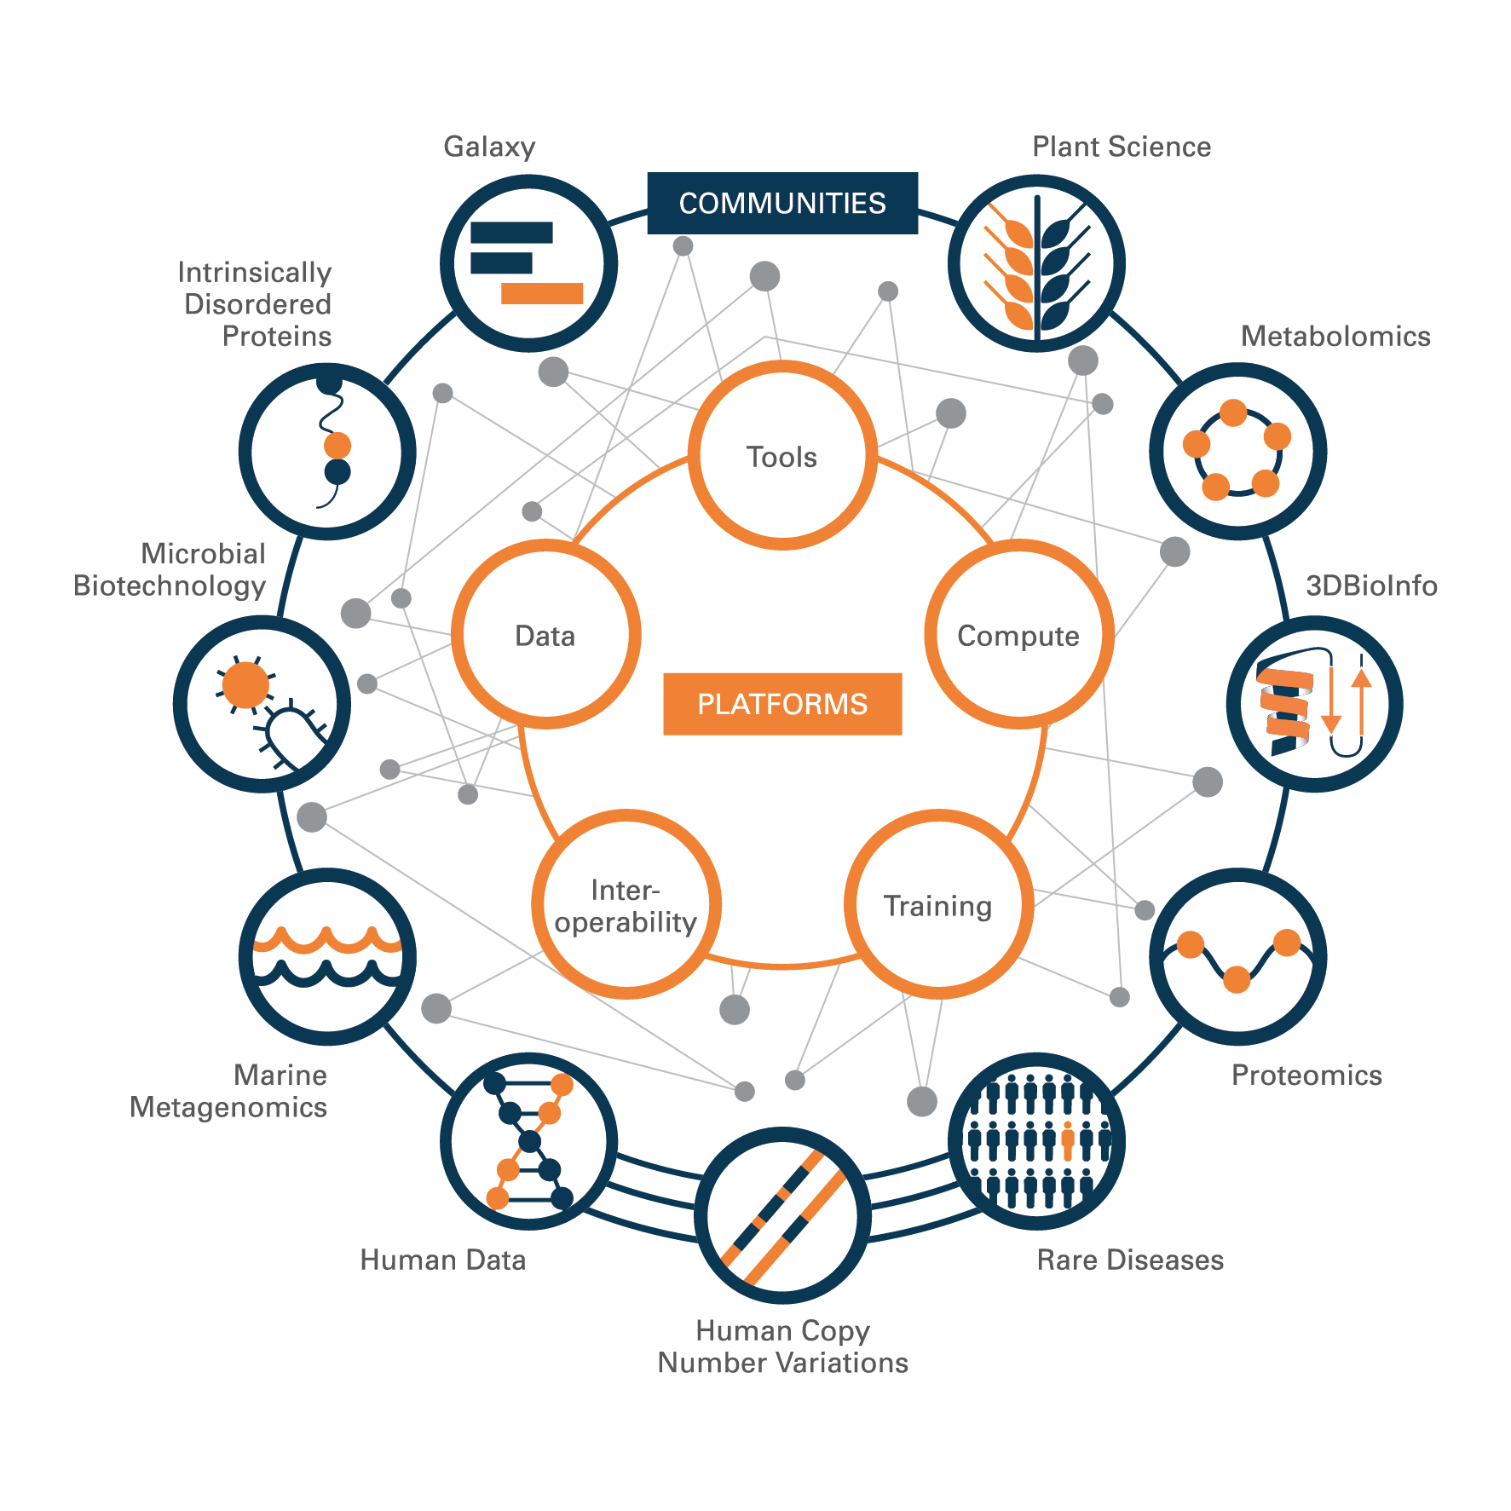
ELIXIR structure
Five technical platforms :
Compute
Data
Tools
Interoperability
Training
Complemented by Communities:
Marine metagenomics
Plants sciences
Proteomics, Metabolomics
Galaxy
Human Data Communities (Rare diseases, Federated human data, Human copy number variation)
Intrinsically Disordered Proteins
Microbial biotechnology

Slide 18
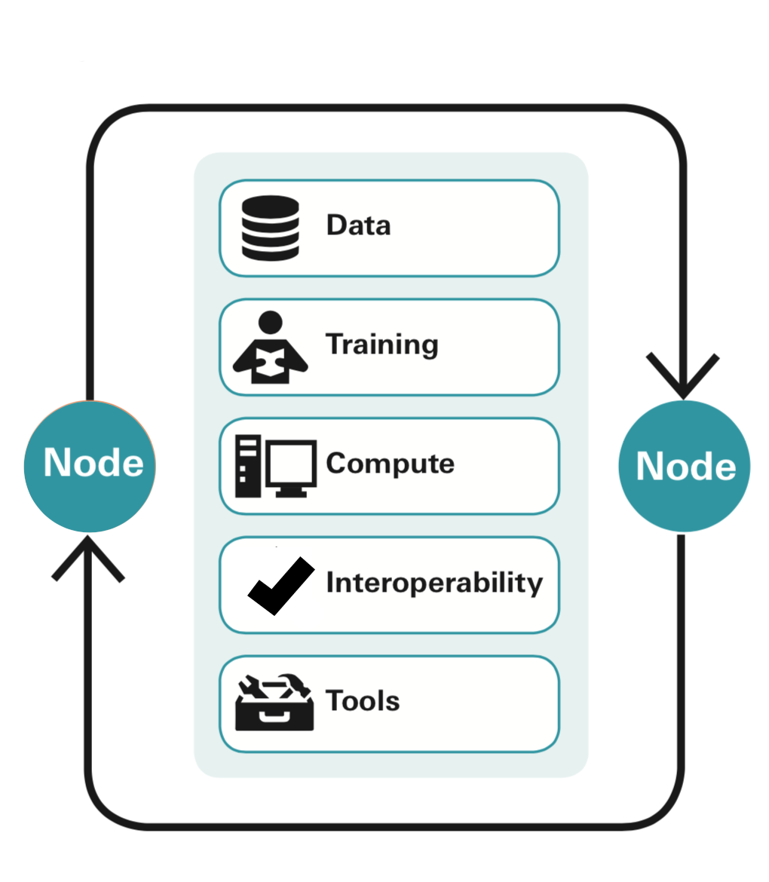
ELIXIR services
Accessed internationally
Operated at national level by ELIXIR Nodes
Funded by national and international schemes
Held together by ELIXIR’s technical programme
Notes:
ELIXIR’s services include databases, tools, standards and how to achieve interoperability of standards, training courses, compute resources, data management support and industry cooperation and technology transfer. The list of services is constantly evolving

Slide 19
ELIXIR services - Data
Aim to drive the use, re-use and value of life science data
Provide long-term sustainable data resources
ELIXIR Core Data Resources – eg. ENA
ELIXIR Deposition Databases – eg. Uniprot
Database services listing
Notes:
Data deposition: ELIXIR Nodes run several data deposition archives where researchers can save their data. Deposition is usually done online and is free as a public resource. The major deposition archives run by ELIXIR Nodes include ENA, EGA, PDBe, EuropePMC
Added-value databases : Added-value databases process, analyse and annotate data (adding comments and other information) from deposition archives and make them accessible to wider scientific community. The added value comes from data processing, additional annotation, or mapping to standardized vocabularies or ontologies (a formal specification of terms and relationships among them). They facilitate the discovery of useful data and the usage of it. Examples of the major knowledge-bases run by ELIXIR Nodes include: UniProt, Ensembl, OrphaNet

Slide 20

ELIXIR services - Training
Aim to develop a training community
Grow bioinformatics training capacity
Build a sustainable training infrastructure
TeSS - training registry for the ELIXIR community
Notes:
Training: ELIXIR Training trains European developers, trainers and researchers within ELIXIR communities. The developers are trained to get a better performance and use relevant methodologies to implement software. Trainers are trained to deliver courses to use ELIXIR services. Researchers are trained to effectively use the tools and services offered by ELIXIR. ELIXIR training portal TeSS collects training related materials - users can browse, discover and organise life science training resources aggregated automatically from ELIXIR Nodes and 3rd party providers.

Slide 21
ELIXIR services - Compute
Aim to build and integrate cloud, compute, storage and access services for the life-science research community
Authentication and authorization
Storage and data transfer
Cloud and computing resources
Notes:
Using Compute services, researchers can carry out computationally intensive modeling and simulation studies and make the most of the big data revolution in the life science. Several ELIXIR Nodes offer Cloud computing services, which enable researchers use compute resources on-demand, without the need to manage their own hardware or datacenter in-house. Services currently available:
Computerome (ELIXIR Denmark,
ePouta, cPouta (ELIXIR Finland)
Embassy cloud (EMBL-BLI)

Slide 22
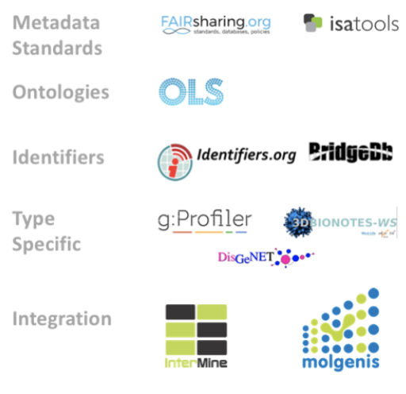
ELIXIR services - Interoperability
Aim to help people and machines to discover, access, integrate and analyse biological data
Encourages the life science community to adopt standardised file formats, metadata, vocabularies and identifiers
Recommend interoperability resources

Slide 23
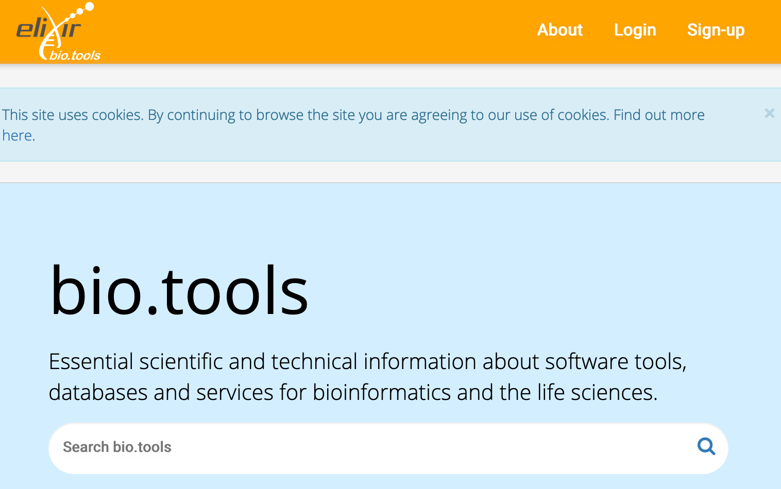
ELIXIR services - Tools
Aim to improve the discovery, quality and sustainability of software resources
Bio.tools is a comprehensive registry of software and databases
ELIXIR Galaxy community contribute to the development of the Galaxy platform
Notes:
Tools: Also to support community efforts on bioinformatics software deployment methods, in particular the BioContainers

Slide 24


What ELIXIR Norway offers
contact@bioinfo.no
Service and collaboration
Support
Access to data, tools, compute & storage
Data management planning
Provide connection to other international ELIXIR nodes
Training and courses
Hands-on workshops

